Slide 1

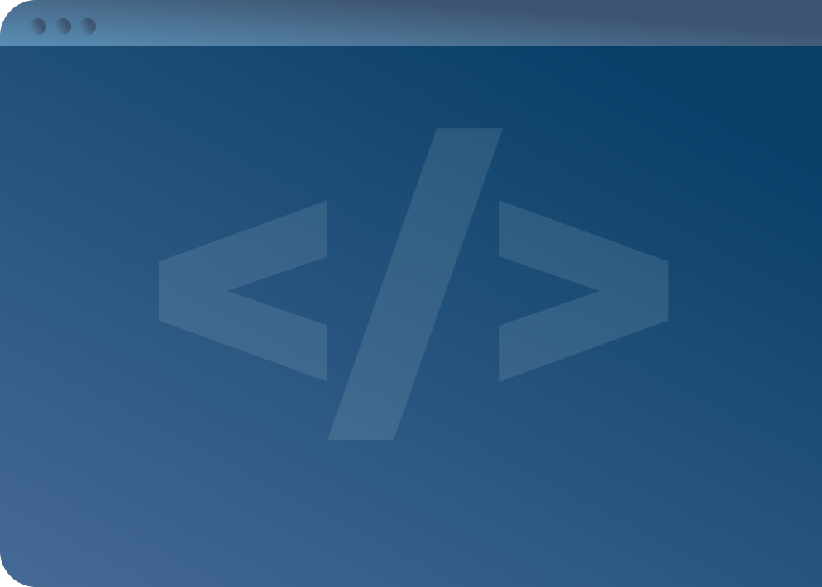

SOFTWARE DEVELOPMENT PROFESSIONAL PROGRAM
Express: Your First Web Framework

Slide 2
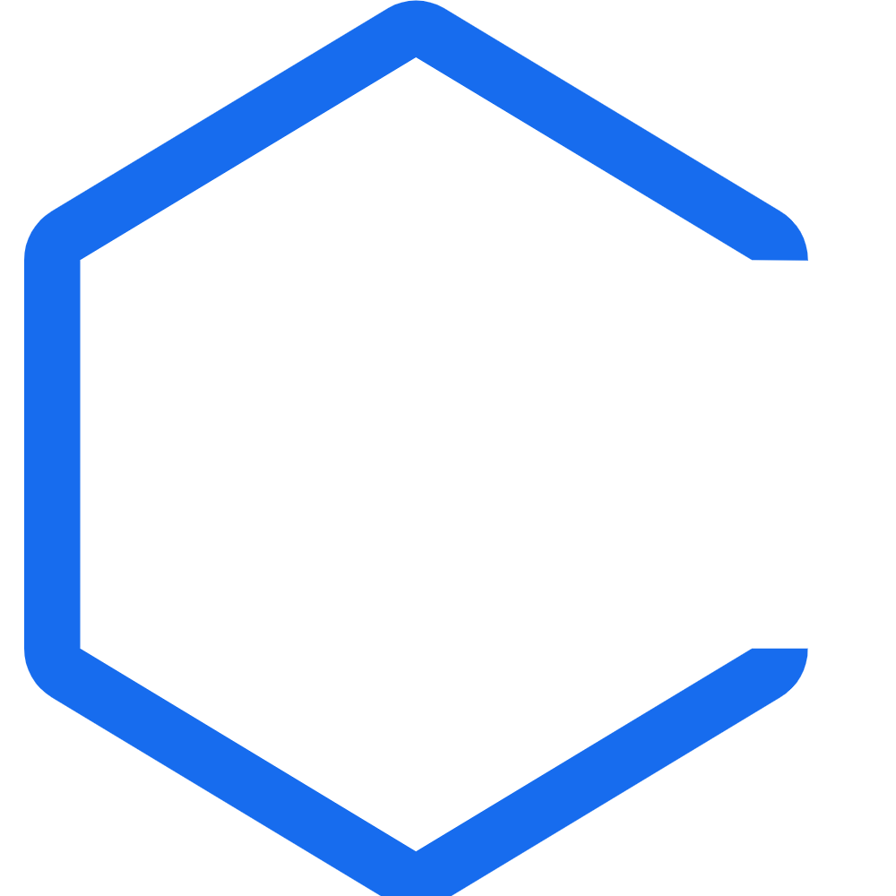
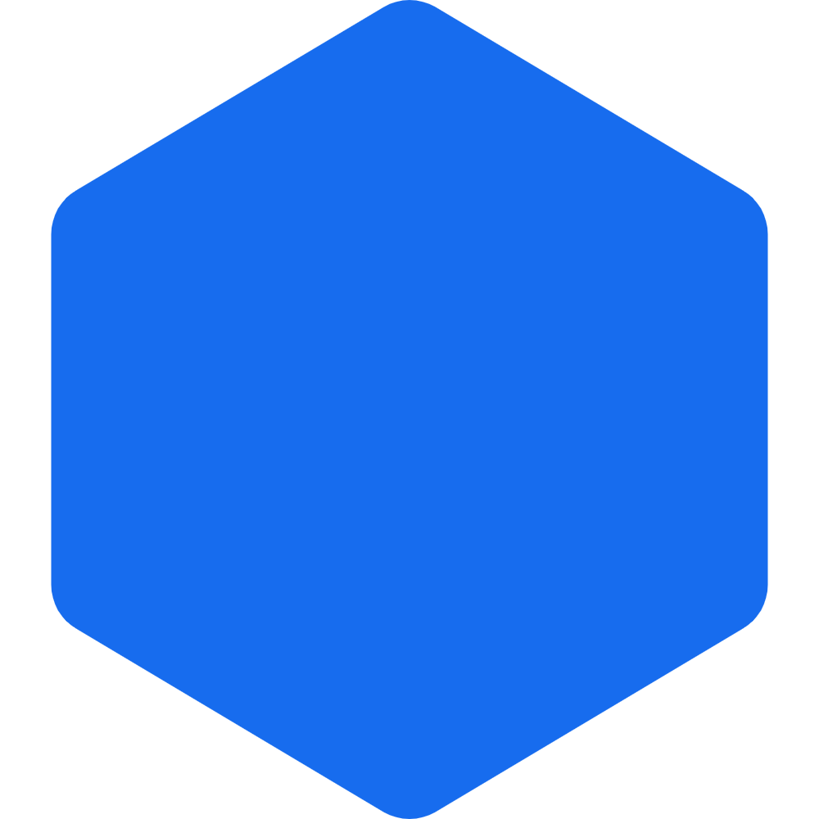
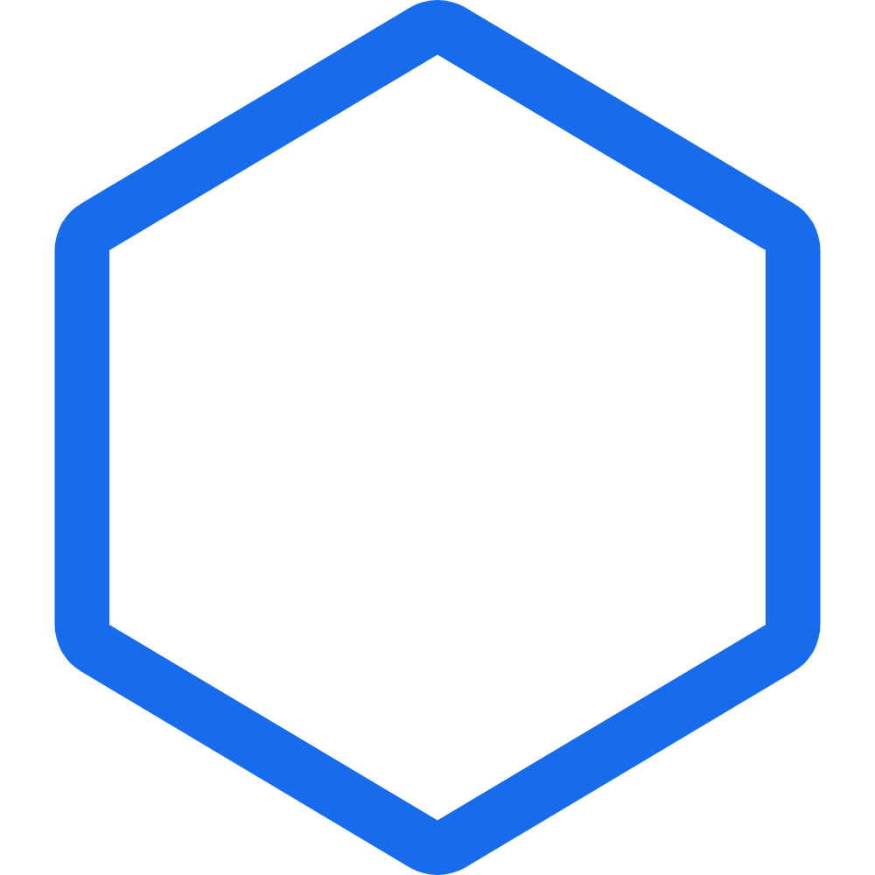


Express: Your First Web Framework
Learning Objectives
Describe the purpose of a web framework.
Name at least three popular web frameworks.
Set up a local web server with Express.

Slide 3

Express: Your First Web Framework
What Is a Web Framework?
"Server-side web frameworks [...] are software frameworks that make it easier to write, maintain, and scale web applications. They provide tools and libraries that simplify common web development tasks..."
Source: Mozilla Developer Network
Notes:
Full quote: "Server-side web frameworks (AKA, 'web application frameworks') are software frameworks that
make it easier to write, maintain, and scale web applications. They provide tools and libraries that
simplify common web development tasks, including routing URLs to appropriate handlers, interacting with
databases, supporting sessions and user authorization, formatting output (e.g., HTML, JSON, XML), and
improving security against web attacks."

Slide 4

Express: Your First Web Framework
In Other Words
Web frameworks exist to make web development easier by providing features you need.
We don't explicitly need a web framework, but they are extremely convenient!
Notes:
Web frameworks make our lives as developers better and easier. Present web frameworks in this context.

Slide 5
Express: Your First Web Framework
Popular Web Frameworks
Framework | Language
Express | Node.js
Flask | Python
Django | Python
Spring Boot | Java
Laravel | PHP
Notes:
In this part of the class, we'll just be using Express, but you'll be pleased to know that the concepts
we'll learn translate well to other frameworks and languages.

Slide 6

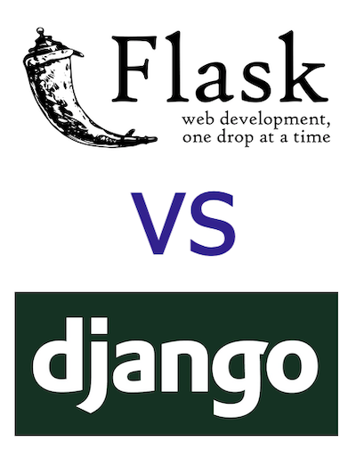
Express: Your First Web Framework
Let's Discuss: Web Framework Features
Flask and Django are Python frameworks.
Why do you think they both exist?
Image Source 2
Notes:
Instructor Note: Try to foster conversation around this topic.
What benefits vs. trade-offs might people expect in different frameworks?
Some things you can add to the conversation, if they don't come up organically:
- Lots of features vs. highly configurable
- Out-of-the-box, ready-to-go features vs. choosing your own tools
- Steep learning curve vs. gentle learning curve

Slide 7
Express: Your First Web Framework
Monolithic vs. Modular
Monolithic
Modular
Many built-in features
Highly customizable
Preset/expected configurations
Choice with configurations
Notes:
Instructor Note: Try not to get too deep into this topic, since learners don't know much about
other web frameworks. This is intended to give them an idea of where Express sits in the ecosystem.

Slide 8

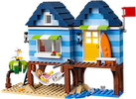

Express: Your First Web Framework
A Series of Trade-Offs
Lego Dollhouse
Pre-Built Dollhouse
vs.
Source
Source
👍We can build any layout in any color we want and add more later.
👍It's nice to use and ready to play with right away!
👎What happens when we need to add a kitchen?
👎There's a bit of overhead, and we have to make some choices.
Notes:
We'll come back to this topic in more detail when we start making websites with Python later
in this class.

Slide 9


Express: Your First Web Framework
How Does Express Fit?
Express is a modular framework.
Think of npm as your Lego box.
If you need something new, just take a look in your box!
Image Source: Pixabay
Notes:
Express is a modular framework. We chose it for this course because:
- It uses the familiar language of JavaScript.
- It is popular, well-supported, and widely used.
- It helps us learn the basics without a lot of unneeded extras.
- npm offers us a rich toolbox with many things to choose from.

Slide 10


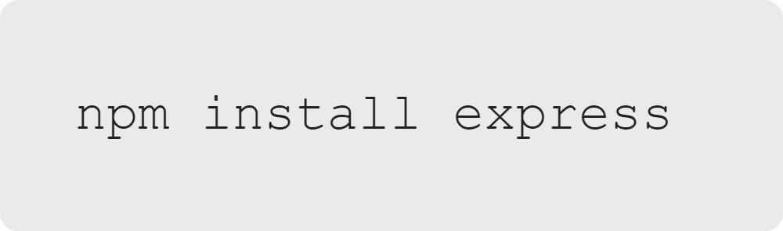
Express: Your First Web Framework
Express: Making Web Development Easier
Express can be installed from npm.
...Just like any other node module!
Image Source
Notes:
Instructor Note: Learners should not be following along here. You can reassure them that they will follow
all of these steps in the activity.

Slide 11
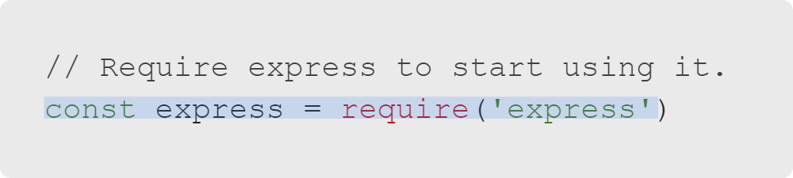
Express: Your First Web Framework
Getting Started: Require
Require Express like any other node module.
Notes:
After installation with npm, you can require Express in your code to begin using it.

Slide 12
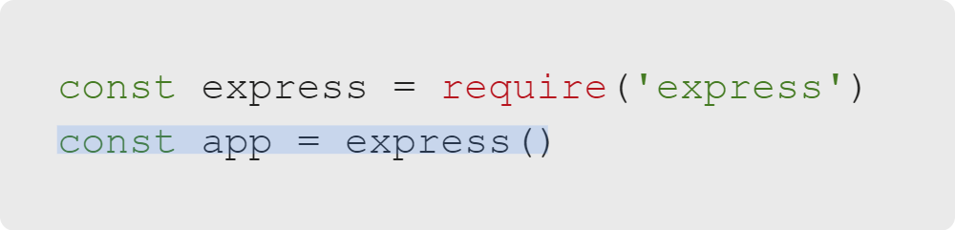
Express: Your First Web Framework
Getting Started: Initialize App
Initialize your Express app.

Slide 13
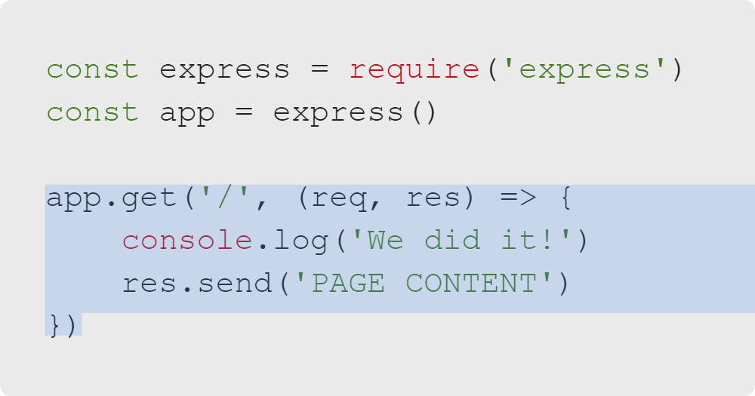
Express: Your First Web Framework
Getting Started: Homepage Route
Make your first route.
get: The HTTP verb
/: The path
req: The HTTP request
res: The HTTP response
callback: Runs when someone visits the page
Notes:
A route is a path that a user would take to reach your webpage.
Notice that here, unlike with the HTTP module, the res.send() method both sends data and ends the connection.

Slide 14
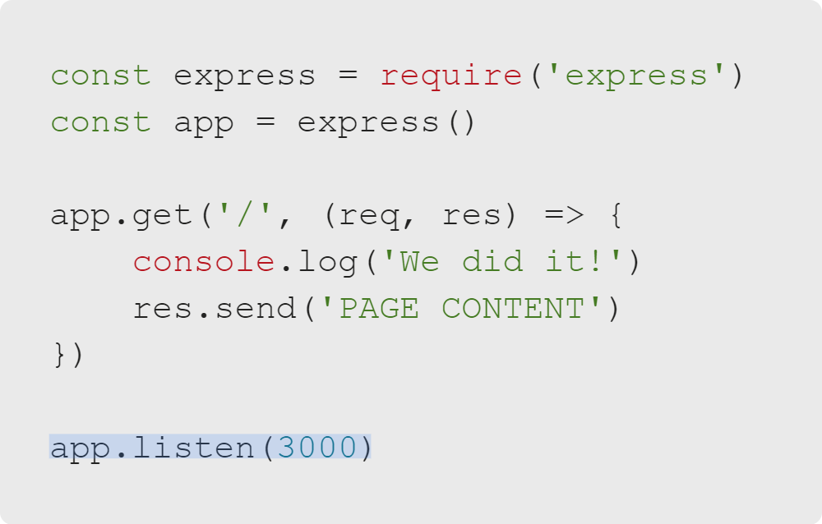
Express: Your First Web Framework
Getting Started: Listen!
Remember, a web server stays open to listen for connections.
Notes:
Remember, a server needs to stay open and listen for connections. We'll use Express's listen method here.

Slide 15

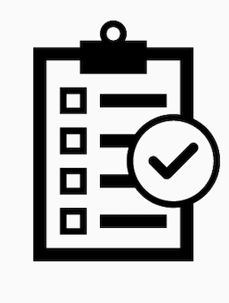
Express: Your First Web Framework
Let's Do It
Let's create and document our first Express app!
Image Source
Notes:
Instructor Note: Move into the code-along activity, "Shortcut List."

